Slide 1
Using health-related quality of life data from children and youth to strengthen HTA
Koonal Shah
Science Policy and Research
ISPOR Europe, November 2024

Slide 2
Declarations
I am an employee of NICE, and a EuroQol member.
My attendance at ISPOR Europe 2024 has been funded by EuroQol.
The views expressed do not necessarily reflect the views of NICE or of EuroQol.

Slide 3
About NICE
NICE helps practitioners and commissioners get the best care to people, fast, while ensuring value for the taxpayer.
We do this by:
Producing useful and usable guidance for health and care practitioners.
Focusing on what matters most by prioritising topics that are most important to the health and care system or address an unmet need.
Providing rigorous, independent assessment of complex evidence for new health technologies.
Encouraging the uptake of best practice to improve outcomes for everyone.
Notes:
Use this slide to explain what NICE does.
Producing useful and usable guidance for health and care practitioners. We’ve published over 300 guidelines containing more than 20,000 evidence-based recommendations across a wide range of topics.
Focussing on what matters most. We prioritise topics that are most important to the health and care system or address an unmet need. We work with industry and other partners to drive the best innovations into the hands of health and care practitioners. NHS patients are often among the first in Europe to access innovative new medicines.
Providing rigorous, independent assessment of new health technologies. Right now, we evaluate around 100 new medicines and technologies each year, but taking an early and proportionate approach will allow us to be even quicker year on year.
Encouraging the uptake of best practice to improve outcomes for everyone. Our guidance is viewed over 10 million times per year and we are an essential part of a health and care system that is always learning from data and implementation.

Slide 4
Instruments used in NICE technology evaluations Generating utilities for children and young people
n=40
Figure adapted from Hill et al. (2020)
https://doi.org/10.1016/j.jval.2020.02.011

Slide 5
Focus on pre-school children (under 5s) Source of utility values in NICE evaluations
n=12
Figure adapted from Lamb et al. (2021) https://doi.org/10.3390/children8090765

Slide 6
NICE methods update (2022)
Academic literature was not deemed mature enough to recommend specific measure(s) and value set(s) for children and young people
The chosen measure should
be a generic measure
have good psychometric performance in the relevant age ranges
Important to report who completed the measure
adults / children and young people / on behalf of children

Slide 7
Challenges and barriers for NICE
Which instrument & completed by whom?
More age-appropriate evidence on psychometric performance
More age-appropriate evidence on content validity
Head-to-head comparisons
Valuation
Population – whose preferences?
Perspective – whose health?
Methods – which valuation technique?
Consistency
Consistency within models
Consistency in decision making

Slide 9
Common challenges in child health technology evaluations
No health-related quality of life data collected in trials
Or if data was collected, an unsuitable instrument was used
Patient population spans childhood and adulthood
Learning difficulties or cognitive impairment can make measurement of health states directly from patients difficult or impossible
Data quality is inevitably poorer, so resulting estimates are more uncertain

Slide 10
Common enquiries to NICE
Availability of EQ-5D-Y utility values for England
Proxy measurement by carers / parents
How to measure health-related quality of life in very young ages
How to account for issues not captured by instruments, e.g. ability to socialise and engage with other children
Assessment of carer quality of life (children typically require full time care when sick)
Issues associated with trial design
Wide age range of the patient population
Learning disabilities

Slide 12
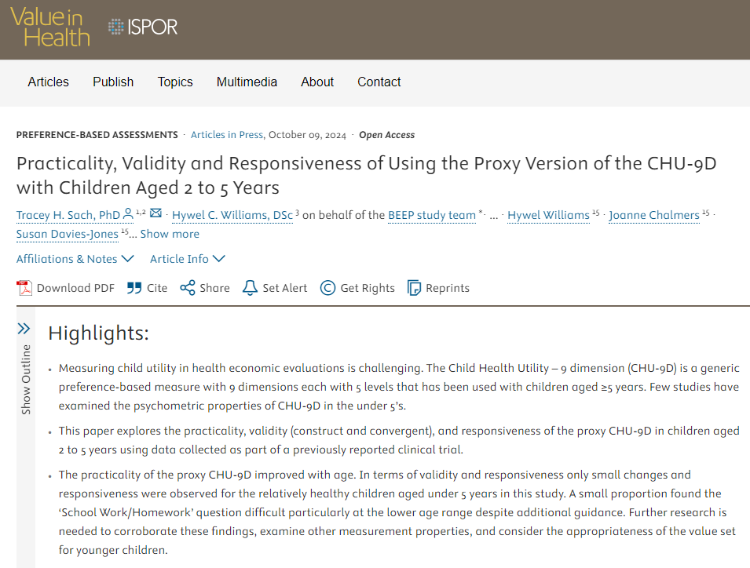

Slide 13
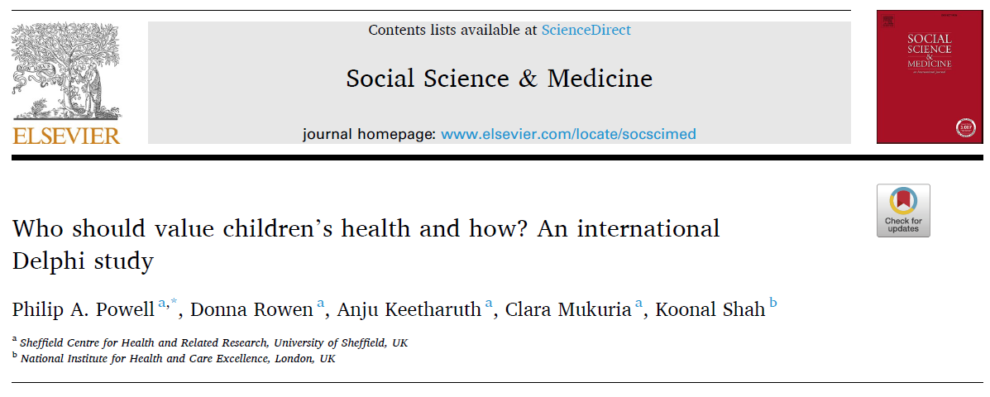

Slide 14
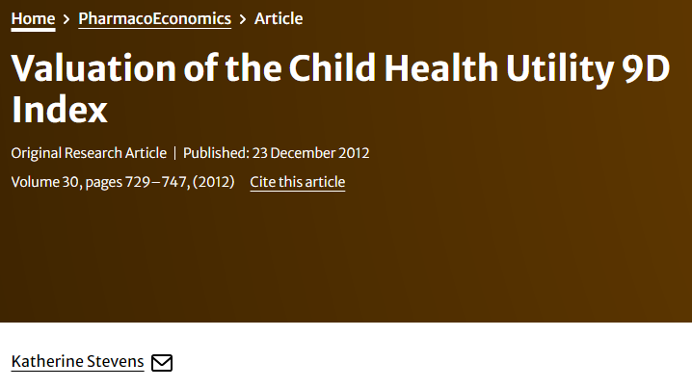
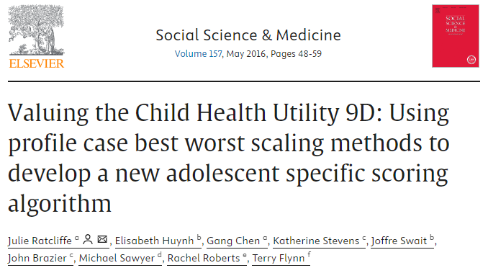
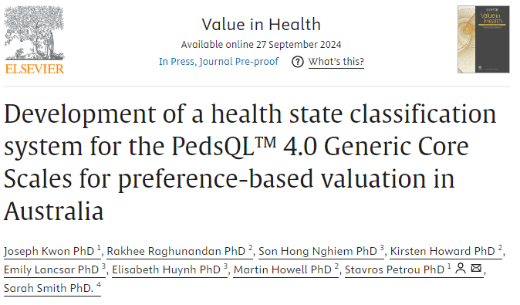
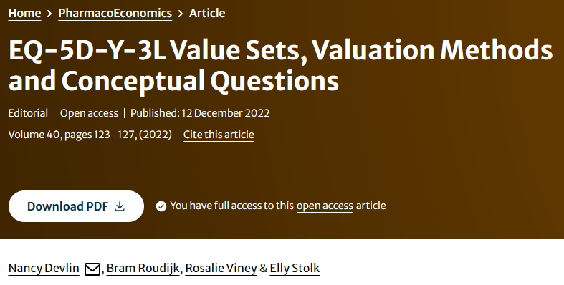

Slide 15
Thank you
© NICE 2024. All rights reserved. Subject to notice of rights.

